Slide 1
Lecture 12
Algorithm Analysis
Arne Kutzner
Hanyang University / Seoul Korea

Slide 2
Minimum Spanning Trees

Slide 3
Introduction - Problem
A town has a set of houses and a set of roads
A road connects 2 and only 2 houses
A road connecting houses u and v has a repair cost w(u, v)
Goal: Repair enough (and no more) roads such that
  everyone stays connected:
  can reach every house from all other houses, and
  total repair cost is minimal
2017/11
Algorithm Analysis
L12.<number>

Slide 4
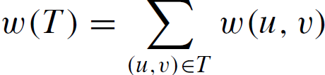
Model as a graph
Undirected graph G = (V, E).
Weight w(u, v) on each edge (u, v) ∈ E.
Find T ⊆ E such that
  T connects all vertices (T is a spanning tree), and
  is minimized.
A spanning tree whose weight is minimum over all spanning trees is called a minimum spanning tree, or MST.
2017/11
Algorithm Analysis
L12.<number>

Slide 5
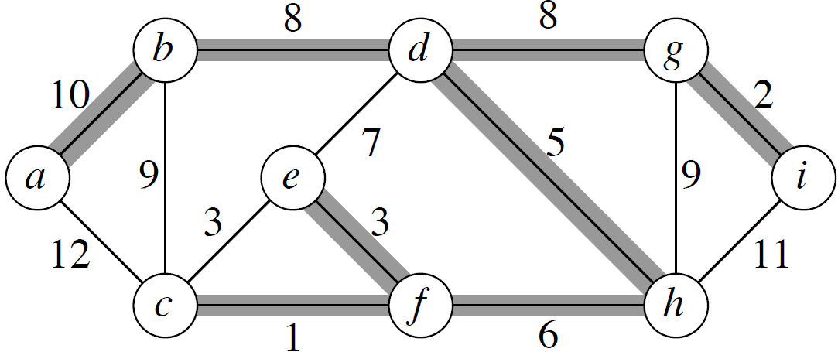
Example
Edges of MST are shaded
In the above graph there is more than one MST. Replace edge (e, f ) by (c, e) and you get a different spanning tree with the same weight
2017/11
Algorithm Analysis
L12.<number>

Slide 6
Growing a Minimum Spanning Tree
Some properties of an MST:
  It has |V| − 1 edges
  It has no cycles
  It might not be unique
Building up the solution
  We will build a set A of edges
  Initially, A has no edges
  As we add edges to A, maintain a loop invariant:
  A is a subset of some MST
  Add only edges that maintain the invariant. If A is a subset of some MST, an edge (u, v) is safe for A if and only if
  A ∪ {(u, v)} is also a subset of some MST.
  So we will add only safe edges.
2017/11
Algorithm Analysis
L12.<number>

Slide 7
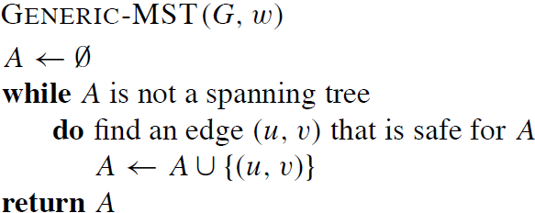
Generic MST algorithm
Use the loop invariant to show that this generic algorithm works.
  Initialization: The empty set trivially satisfies the loop invariant.
  Maintenance: Since we add only safe edges, A remains a subset of some MST.
  Termination: All edges added to A are in a MST, so when we stop, A is a spanning tree that is also an MST.
2017/11
Algorithm Analysis
L12.<number>

Slide 8
Some Definitions
Let S ⊂ V and A ⊆ E
A cut (S, V − S) is a partition of vertices into disjoint sets V and V − S.
Edge (u, v) ∈ E crosses cut (S, V − S) if one endpoint is in S and the other is in V − S.
A cut respects A if and only if no edge in A crosses the cut.
An edge is a light edge crossing a cut if and only if its weight is minimum over all edges crossing the cut. (For a given cut, there can be > 1 light edge crossing it.)
2017/11
Algorithm Analysis
L12.<number>

Slide 9
Central Theorem
Theorem: Let A be a subset of some MST, (S, V − S) be a cut that respects A, and (u, v) be a light edge crossing (S, V − S). Then (u, v) is safe for A.
Proof: Let T be an MST that includes A.
  (a) If T contains (u, v), done.
  (b) If T does not contain (u, v), we will construct a different MST T' that includes
  A ∪ {(u, v)}.
2017/11
Algorithm Analysis
L12.<number>

Slide 10
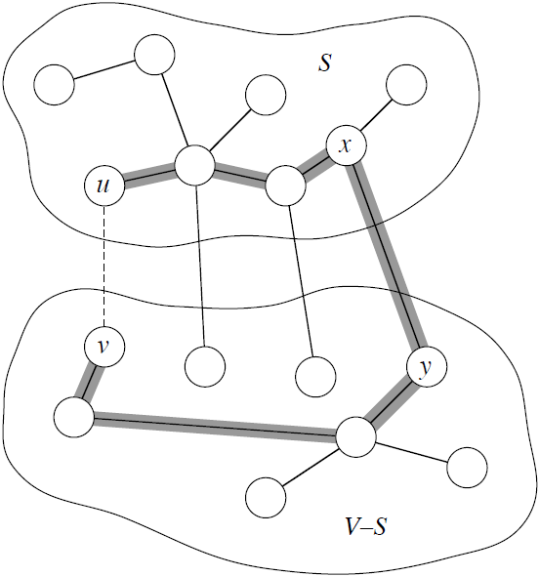
Central Theorem - Proof (cont.)
A tree has unique path between each pair of vertices
Since T is an MST, it contains a unique path p between u and v. Path p must cross the cut
(S, V − S) at least once
Let (x, y) be an edge of p that crosses the cut.
From how we chose (u, v), must have w(u, v) ≤ w(x, y)
2017/11
Algorithm Analysis
L12.<number>

Slide 11
Central Theorem - Proof (cont.)
Since the cut respects A, edge (x, y) is not in A.
To form T' from T :
  Remove (x, y) in order to Split T into two components
  Add (u, v) in order to reconnect.
So T' = T − {(x, y)} ∪ {(u, v)}.
T' is a MST. Because T' is a spanning tree and:
  w(T') = w(T ) − w(x, y) + w(u, v)
  ≤ w(T)
2017/11
Algorithm Analysis
L12.<number>

Slide 12
Central Theorem - Proof (cont.)
Finally we have to show that (u, v) is safe for A:
  A ⊆ T and (x, y) ∉A ⇒ A ⊆ T'
  A ∪ {(u, v)} ⊆ T'
  Since T' is an MST, (u, v) is safe for A
Corollary
If C = (V_{C}, E_{C}) is a connected component in the forest G_{A} = (V, A) and (u, v) is a light edge connecting C to some other component in G_{A} (i.e., (u, v) is a light edge crossing the cut (V_{C}, V − V_{C})), then (u, v) is safe for A.
2017/11
Algorithm Analysis
L12.<number>

Slide 13
Kruskal’s Algorithm

Slide 14
Kruskal’s Algorithm - Structure
G = (V, E) is a connected, undirected, weighted graph. w : E → R.
  Starts with each vertex being its own component.
  Repeatedly merges two components into one by choosing the light edge that connects them (i.e., the light edge crossing the cut between them).
  Scans the set of edges in monotonically increasing order by weight.
  Uses a disjoint-set data structure to determine whether an edge connects vertices in different components.
2017/11
Algorithm Analysis
L12.<number>

Slide 15
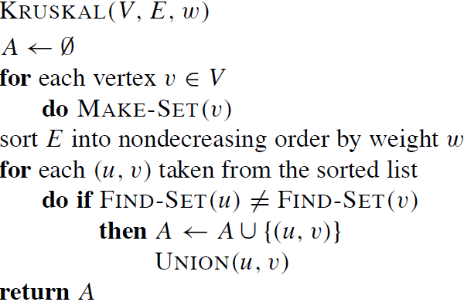
Kruskal’s Algorithm - Pseudocode
2017/11
Algorithm Analysis
L12.<number>

Slide 16
Kruskal’s Algorithm - Analysis
Basics:
  Initialize A: O(1)
  First for loop: |V| MAKE-SETs
  Sort E: O(E lg E)
  Second for loop: O(E) FIND-SETs and UNIONs
Assuming the implementation of disjoint-set data structure, presented in the Textbook in Chapter 21, that uses union by rank and path compression:
  O((V + E) α(V)) + O(E lg E)
  |E| ≤ |V|² ⇒ lg |E| ≤ 2 lg |V| = O(lg |V|) = O(lg E)
  α(|V|) = O(lg V) = O(lg E)
  Since G is connected, |E| ≥ |V| − 1⇒ O(E α(V)) + O(E lg E)
  Therefore, total time is O(E lg E)
  We can restate the running time as O(E lg V)
2017/11
Algorithm Analysis
L12.<number>

Slide 17
Prim’s Algorithm

Slide 18
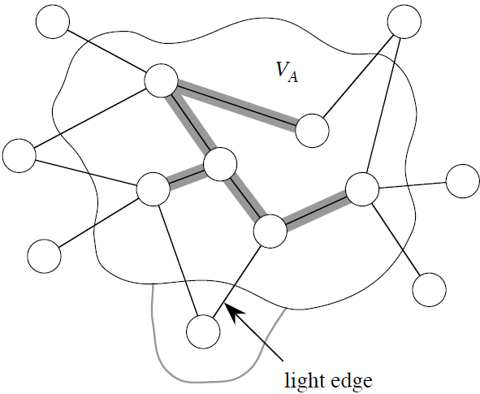
Prim’s Algorithm
Builds one tree, so A is always a tree
Starts from an arbitrary “root” r
At each step, find a light edge crossing cut (V_{A}, V − V_{A}), where V_{A} = vertices that A is incident on. Add this edge to A.
2017/11
Algorithm Analysis
L12.<number>

Slide 19
Prim’s Algorithm (cont.)
How to find the light edge quickly?
Use a priority queue Q:
  Each object is a vertex in V − V_{A}
  Key of v is minimum weight of any edge (u, v), where u ∈ V_{A}.
  Then the vertex returned by EXTRACT-MIN is v such that there exists u ∈ V_{A} and (u, v) is light edge crossing (V_{A}, V − V_{A})
  Key of v is ∞ if v is not adjacent to any vertices in V_{A}.
2017/11
Algorithm Analysis
L12.<number>

Slide 20
Prim’s Algorithm (cont.)
The edges of A will form a rooted tree with root r:
  r is given as an input to the algorithm, but it can be any vertex
  Each vertex knows its parent in the tree by the attribute π[v] = parent of v
  π[v] = NIL if v = r or v has no parent
  As algorithm progresses,
  A = {(v, π[v]) : v ∈ V − {r} − Q}
  At termination, V_{A} = V ⇒ Q = ∅,
  so MST is A = {(v, π[v]) : v ∈ V − {r}}
2017/11
Algorithm Analysis
L12.<number>

Slide 21
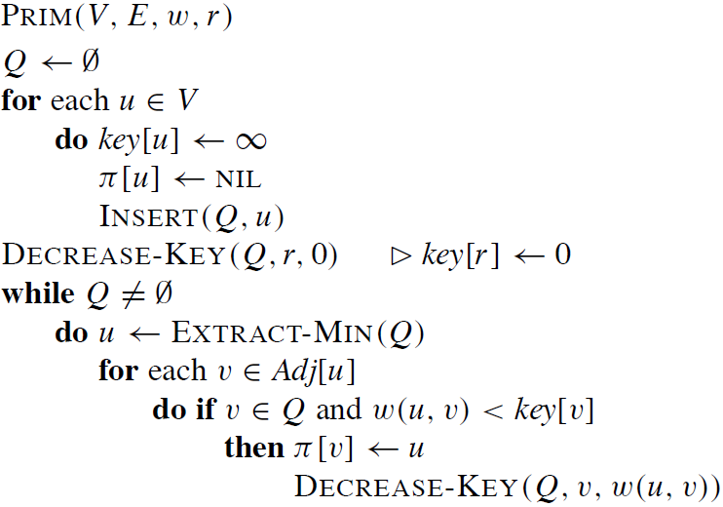
Prim’s Algorithm - Pseudocode
2017/11
Algorithm Analysis
L12.<number>

Slide 22
Complexity - Analysis
Depends on how the priority queue is implemented:
Suppose Q is a binary heap.
  Initialize Q and first for loop: O(V lg V)
  Decrease key of r : O(lg V)
  while loop:
  |V| EXTRACT-MIN calls ⇒ O(V lg V)
  ≤ |E| DECREASE-KEY calls ⇒ O(E lg V)
  Total: O(E lg V)
2017/11
Algorithm Analysis
L12.<number>

